Slide 1
Plastic Turtle
East Coast Gang

Slide 2
Ideation: Concepts
Keep the Ocean Clean, Save the Turtles.
Target Group: 14+
The game is about a baby turtle that has to survive the trash from the ocean. You start out in the clean ocean water, minding your own business and growing up. As soon as you reach adolescence the ocean begins to become riddled with trash, not much but it slowly becomes abundant. At adult-hood you live to see your once beautiful home, become a festering place for disease, trash everywhere, water is green. You become stuck and you die.
https://www.seeturtles.org/help-save-turtles
A day in the life on the run.
Target Group: 18+
You are a Syrian refugee trying to escape Turkey and Bulgaria and all of the eastern part of Europe. Join the merry band of refugees in their quest to reach France. You will encounter the daily struggles of an average refugee. Shortage of food, no place to really rest, no place to call home. This game is here to allow the people that don’t know what’s happening to truly feel the experience and hardships a refugee has to go through.
https://helprefugees.org
Plant some trees, give Koalas a home.
Target Group: 14+
The games objective is to save koalas from the burning wildfires in Australia by having the opportunity to extinguish said fires and potentially replant burnt down trees. As time progresses more and more fires will appear and spread and it will become harder for the player to aid eventually leading to the forest burn down. The closing screen could be a warning message to take responsibility.
www.savethekoala.com

Slide 3
Keep the Ocean Clean, save the Turtles
An endless runner game that shows the player, the life of a turtle, from it being a hatchling to it being a full grown adult.
The main gimmick of the game is to keep the turtle alive by constantly avoiding the trash while eating the food, keeping track of the health and food bar.
As time passes the game will get gradually harder in the means of there being less food and more and more trash. The background scene will change as the player progresses showing how the ocean was really affected by the lack of interest from the people.
To keep track of progress, the game will include a time-tracker that shows the player how much he has gone in age from the beginning. This tracker will help the player remember where he has finished his last run.

Slide 4
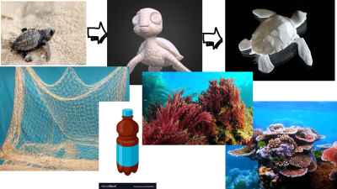
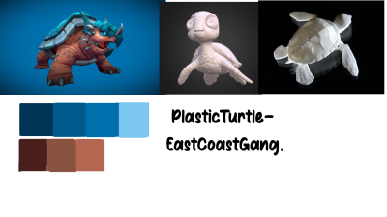
Ideation: Style
MoodBoard
StyleSheet

Slide 5
Ideation: Empathy Map
Who are we empathizing with?
“Fridays for future” movement. They worry about the future.
They try to raise awareness of the situation, for those who do not know the dire circumstances.
What do they need to DO
They have to start talking about the situation, showing articles, videos and different kinds of media about this to friends, family and other people.
They want to save the Ocean Wildlife. This can be done by doing the following things. Zero Waste in the Ocean. Employing alternative ways to deal with achieving electricity. Being more mindful of electricity usage.
They have to make conscious decisions regarding the things they buy and how to properly dispose of them. They have to start recycling materials and buying reusable packages, bags, bottles etc.
Time is what is going to acknowledge their success, the majority of the endangered wildlife will become threatened or less. The lack of spillage will be noticeable soon.
What do they SEE?
They see organizations trying to raise awareness of the situation but to no avail, though with every small donation a part of their work actually happens. They see people littering. Countries buying trash off-shore to satisfy their disposal needs. The different recycling bins having all kinds of trash inside of them, and people not respecting that.

Slide 6
Ideation: Empathy Map
What do they SAY?
They encourage people to start recycling, to be wary of their energy consumption, to implement a better, more efficient way of getting their energy which can be renewable.
They might encourage people to stop littering, start buying ecological bags and materials, same with the food.
What do they DO?
They start to gather the litter off the beaches, in parks and recycle said trash. They are eco- friendly with everything they buy and try to sell, they start businesses that encourage the use of recycled materials. They try to influence other people to stop wasting so much energy
What do they HEAR?
They hear that people aren’t aware of the situation and continue their lives without a care. Their friends try to help as much as they can. Their second-hand information that they receive is that there isn’t much that they can do.
What do they THINK and FEEL?
PAINS: They fear that this problem will go unnoticed and thus the wildlife of the ocean will surely die in the future. They are frustrated about everyone who isn’t doing anything to stop this and are anxious to see what is going to happen in the future.
GAINS: They want the world to notice this problem and it has to happen fast. They need to raise awareness of the situations and their hopes and dreams is that this problem would eventually dissolve.

Slide 7
Ideation: Hook Model
Trigger Internal:
1) What does the user really want? The user wants to be informed about the newly endangered species of the turtles and wants to know what led to this.
Trigger External:
2) What gets the user to the product? He wants to see what the life of a turtle looks like.
Action:
3) What is the simplest behaviour in anticipation of reward => the user does what it thinks is right for the turtle, avoiding the trash and eating the food, thus making the turtle grow healthy.
Variable Reward:
4) Is the reward fulfilling, yet leaves the user wanting for more? The user has made the turtle grow from a hatchling to a teen as he sees there is so much more time left until he fully develops into an adult. He anticipates his growth and wants to get there.
Investment:
5) What is the ‘bit of work’ done to increase the likelihood of returning? As the user sees that the turtle has grown up into an adult, himself helping it, working with it and seeing it lose its life to the contaminated waters of the ocean. The user wants to try again, to save the turtle which inevitably will lose its life.

Slide 8
Ideation: SWOT analysis.
Strengths:
We have a strong message to deliver that is tackling a really big issue in the world at the moment, and not involving only turtles, the wastes that are thrown in the ocean are destroying all kinds of habitats. Affecting all wildlife and damaging a really important side of our planet.
Weaknesses:
The problem of the strong message is that people prefer to not care about them and look in the other direction. Hence lots of our mainly adult following would probably not really involve themselves that much in this kind of matter.
Opportunities:
By making this game accessible to everyone and its style being somewhat cartoonish, we hope that kids, teens and young adults would give much more attention to this cause. Them being the stepping stone of the future, only they can truly bring back the truly blue and beautiful ocean.
Threats:
We are being too reliant on the children, teens and young adults hence if them are not showing any interest in this matter everything would turn bad.

Slide 9
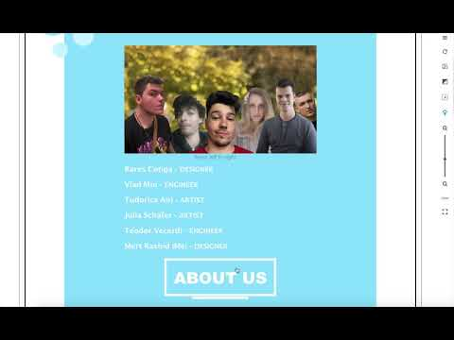
Promotional Material: Website

Slide 10
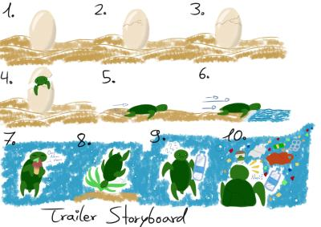
Promotional Material: Trailer
STORYBOARD and Trailer Idea.
The trailer will be mainly a combination of storyboard art and gameplay.
The trailer will begin with the first crawl of life of the turtle hatchling and showing him find good and healthy food. Fading to gameplay for each of its "unique" encounters

Slide 11

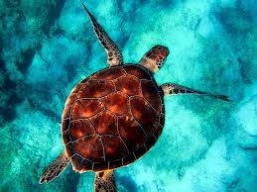
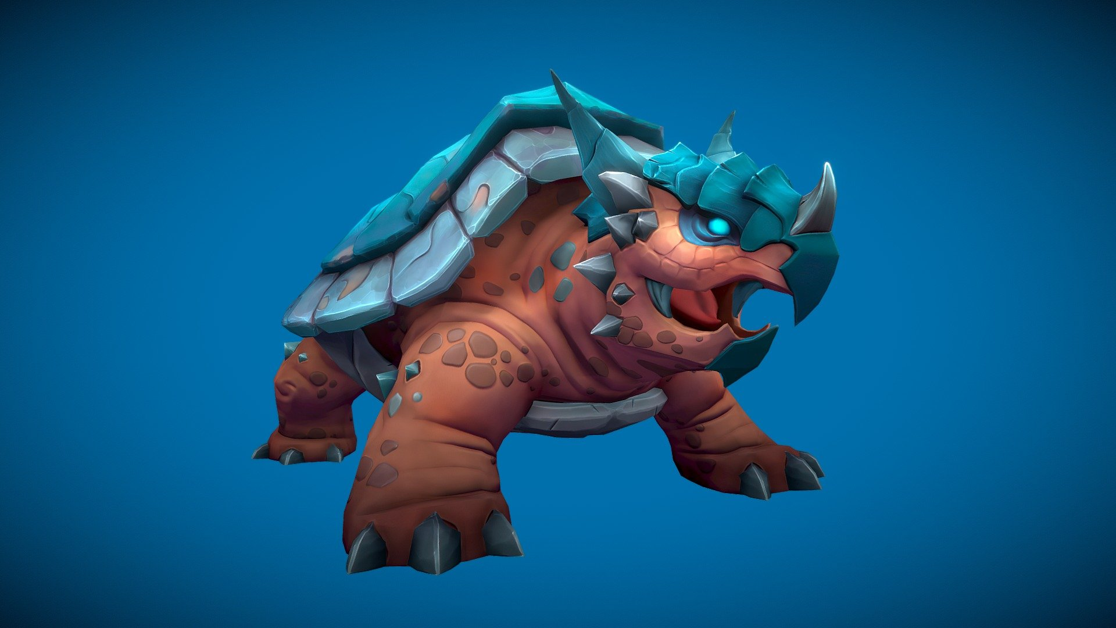
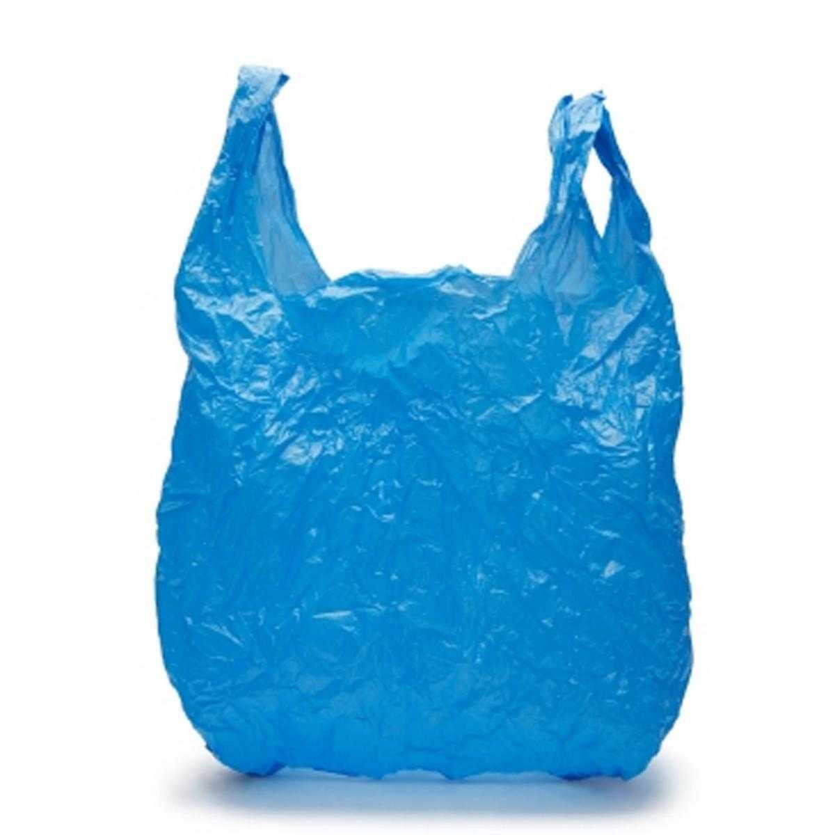

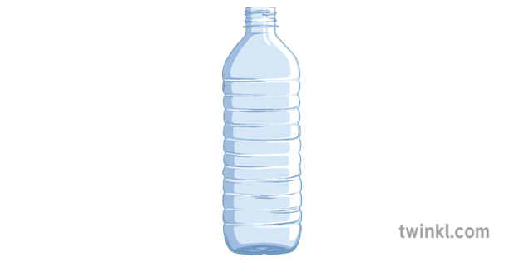
3D Assets:
Reference:

Slide 12
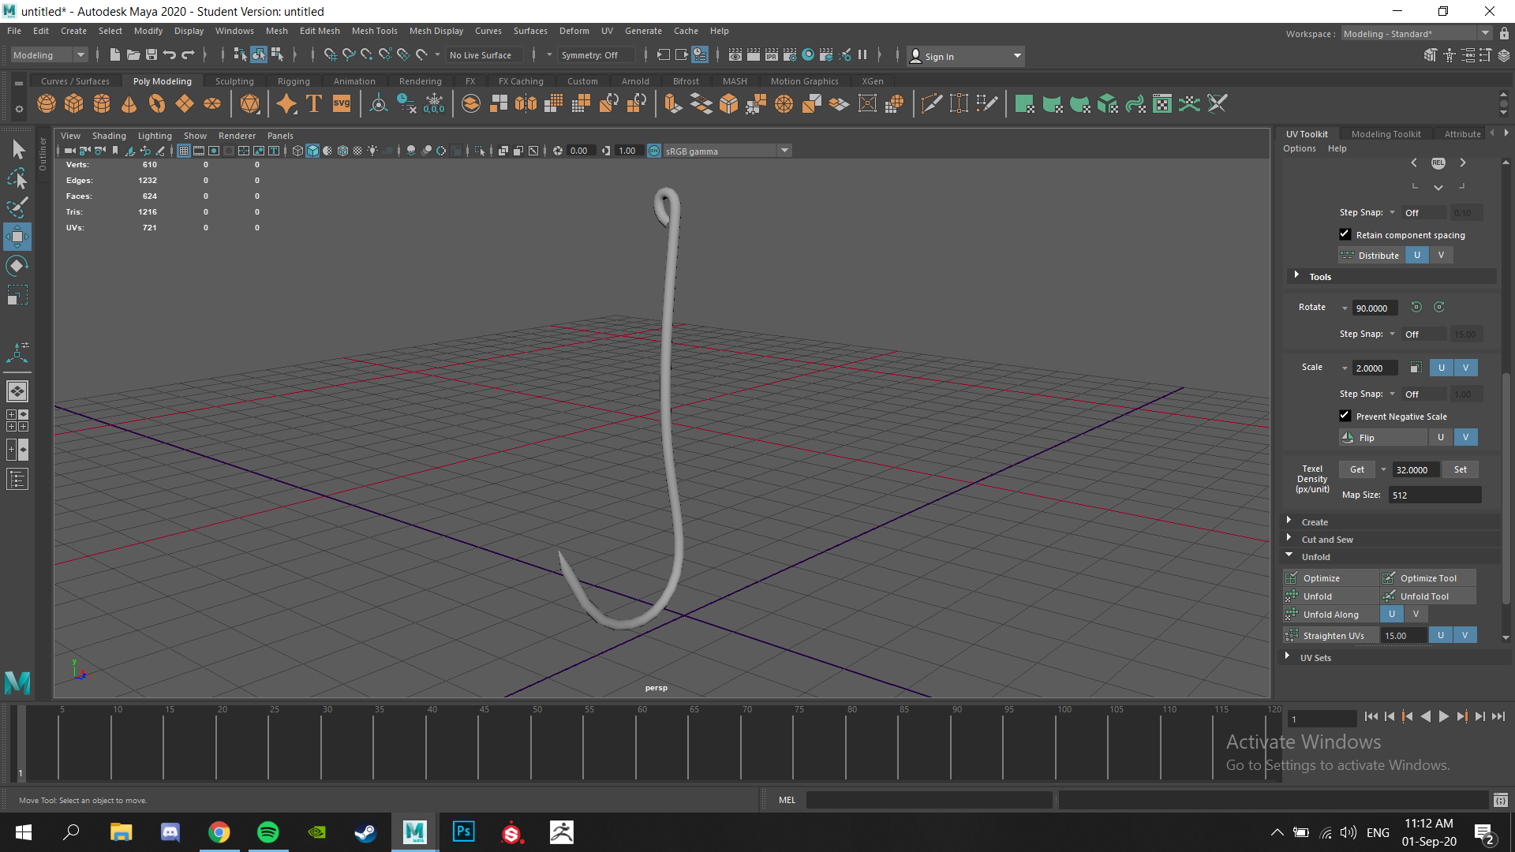
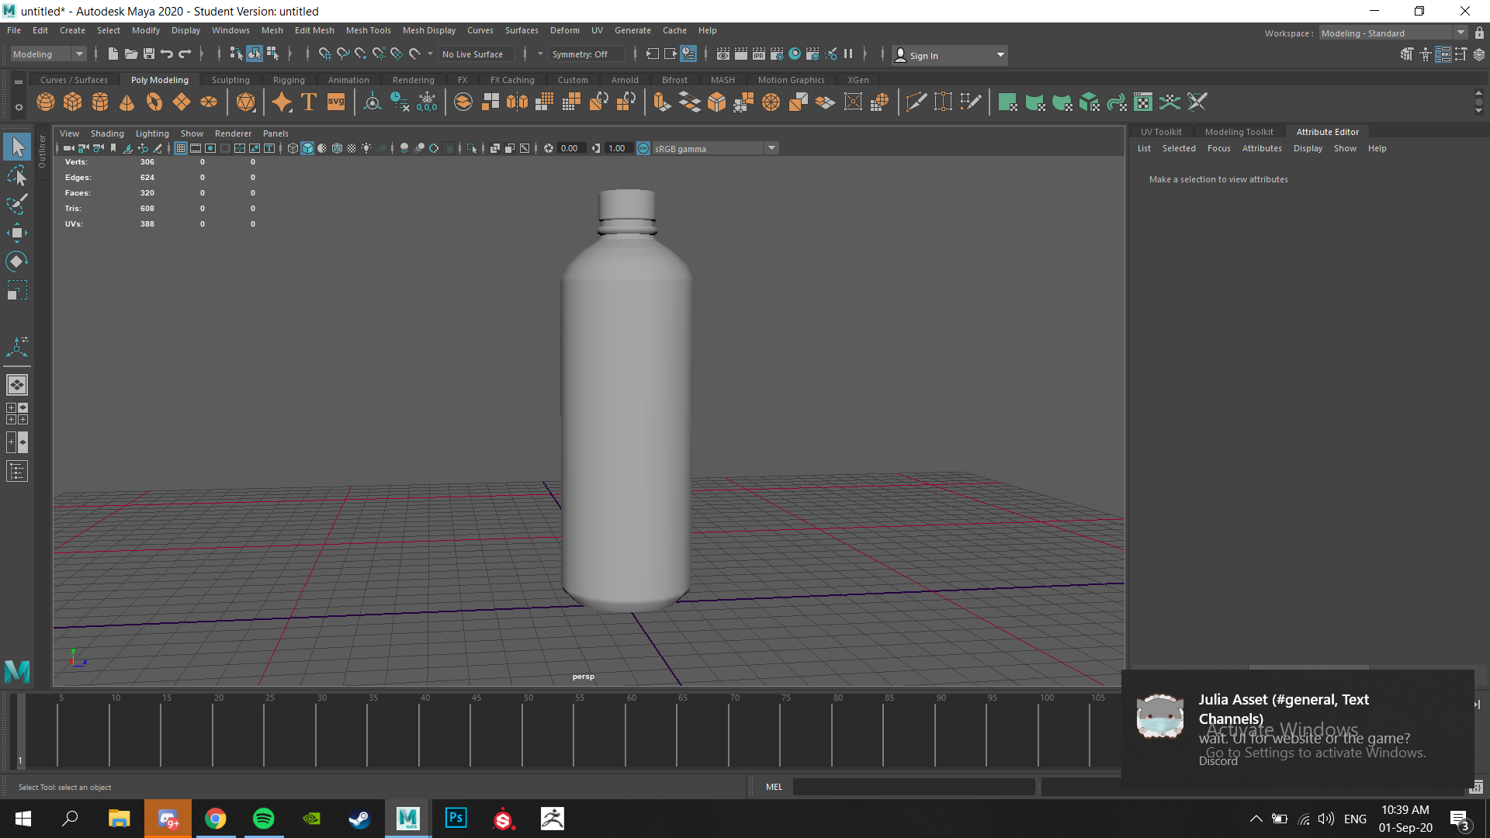
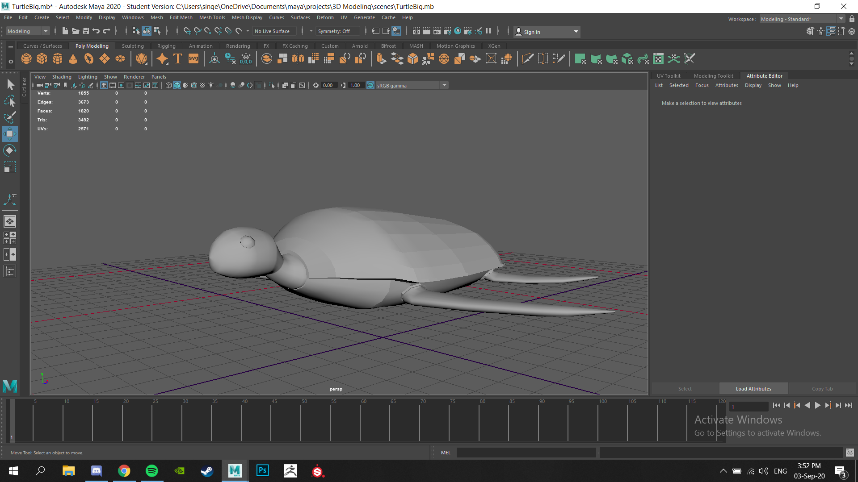
3D Models:

Slide 13
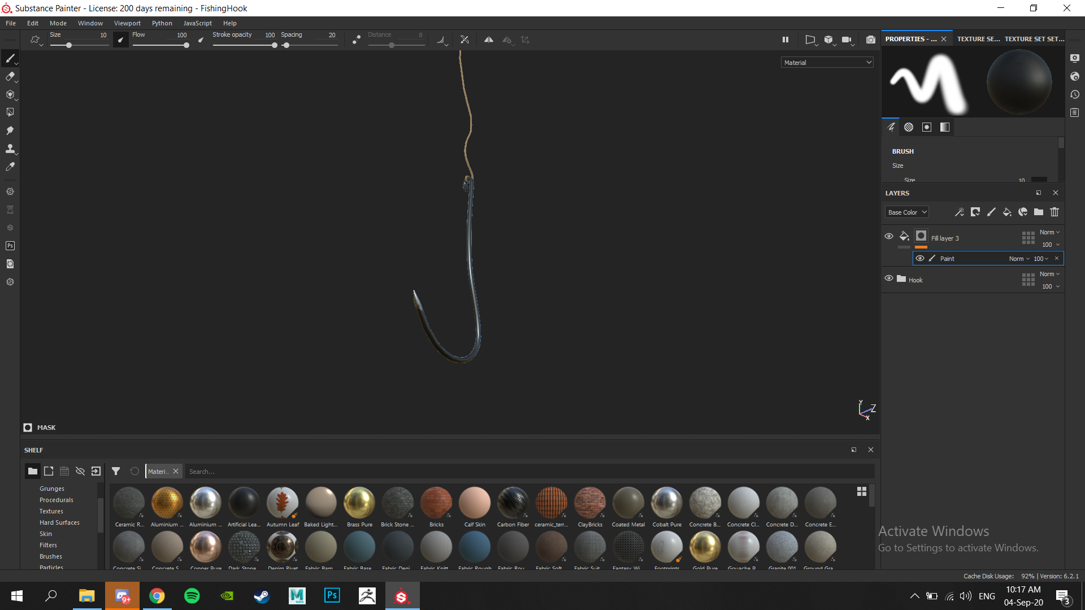
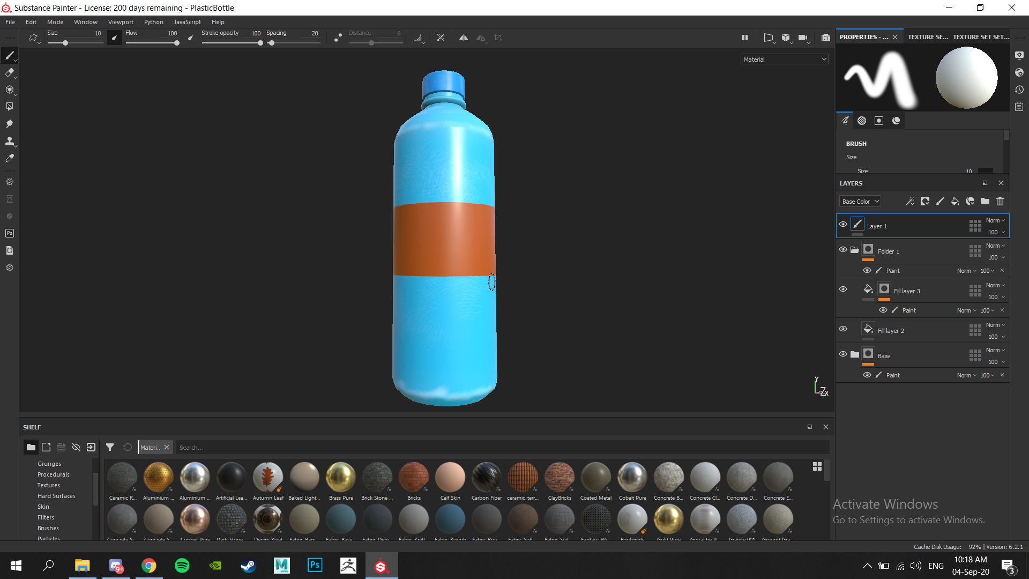
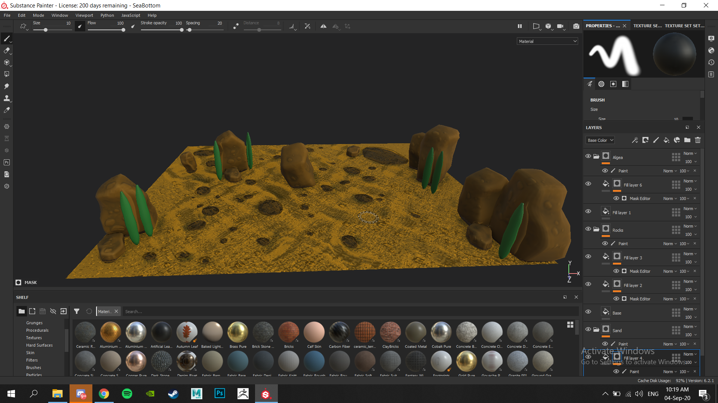
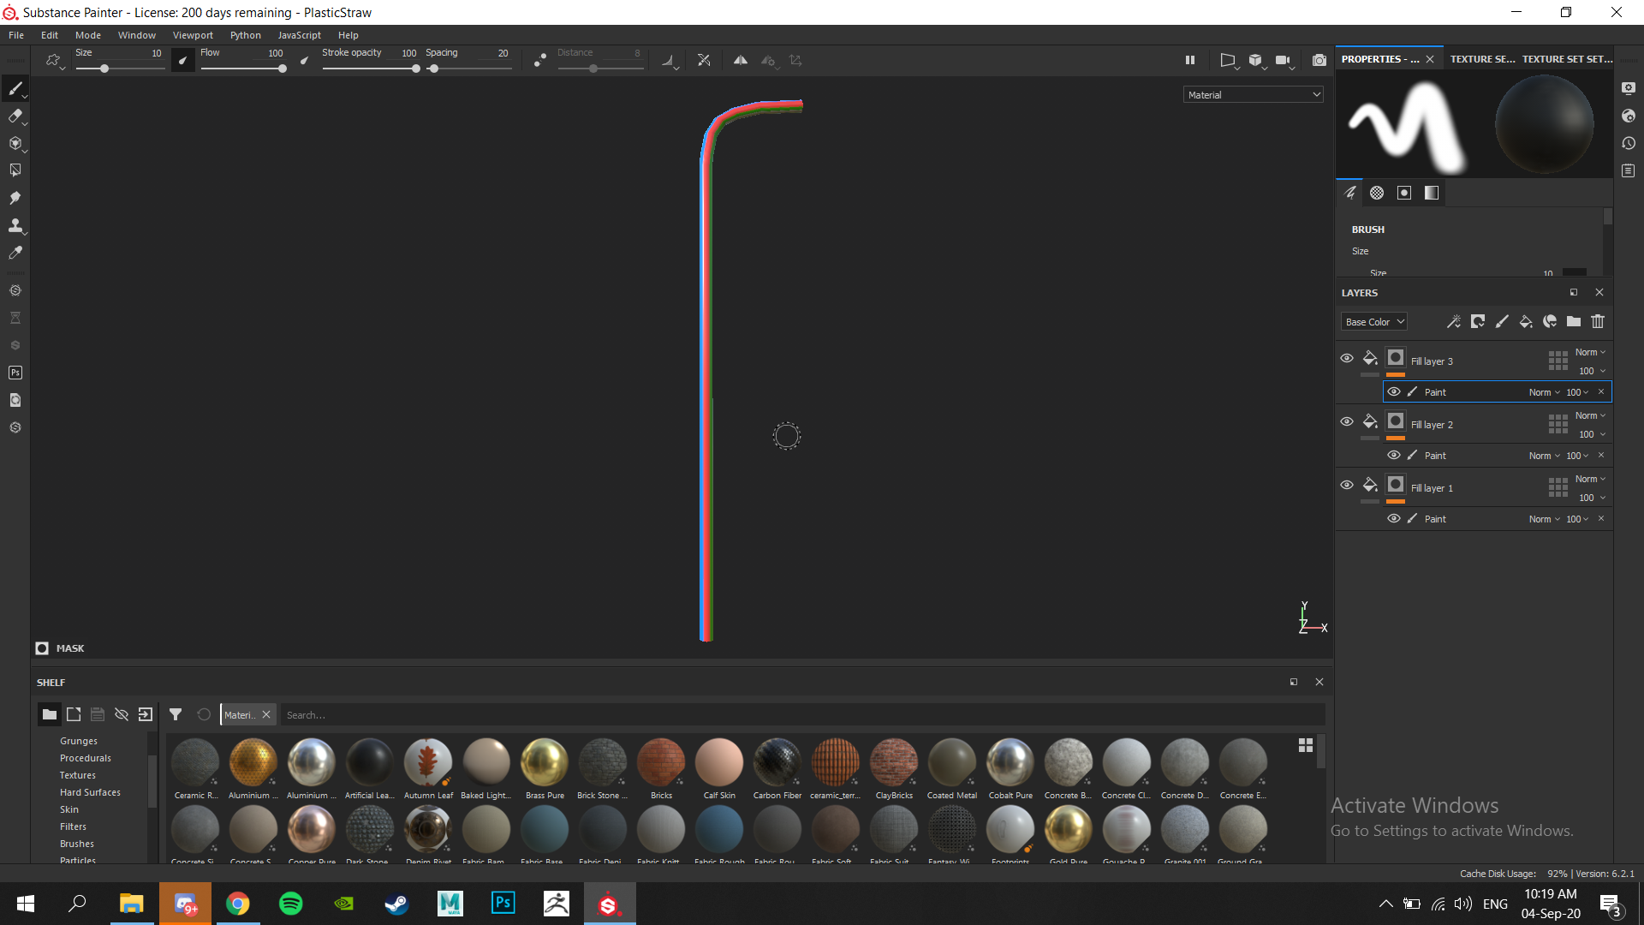
Texturing:

Slide 14
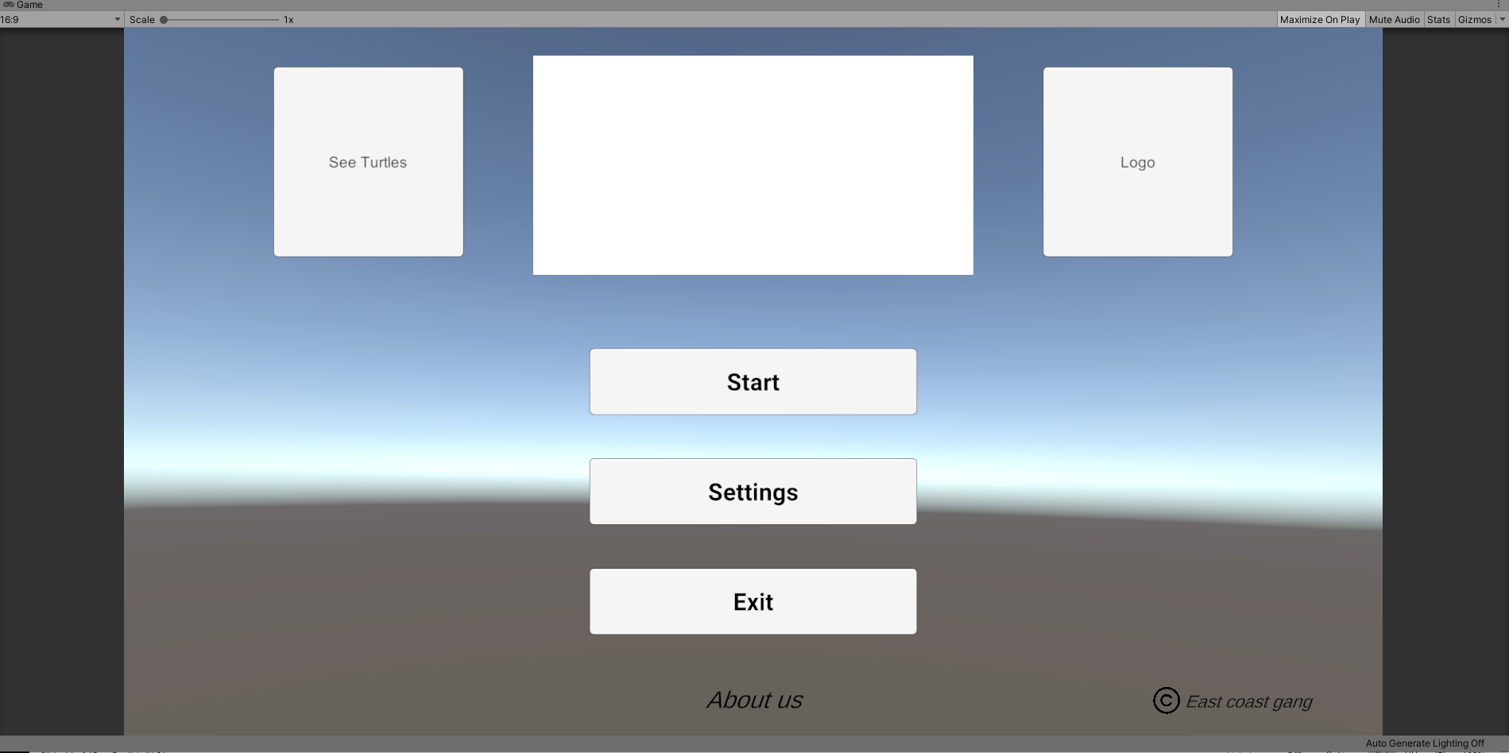
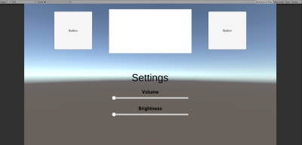
Game: UI/UX Menu
Main Menu and Settings
The UI/UX is currently at a wireframe stage and the settings menu is missing a back button.
The side buttons are going to be the logos of our game and the campaign we are supporting. All the buttons are functional except the sliders (for now).
In the middle there will be a sprite with our game's title.

Slide 15




Game: UI/UX In-Game

Slide 16
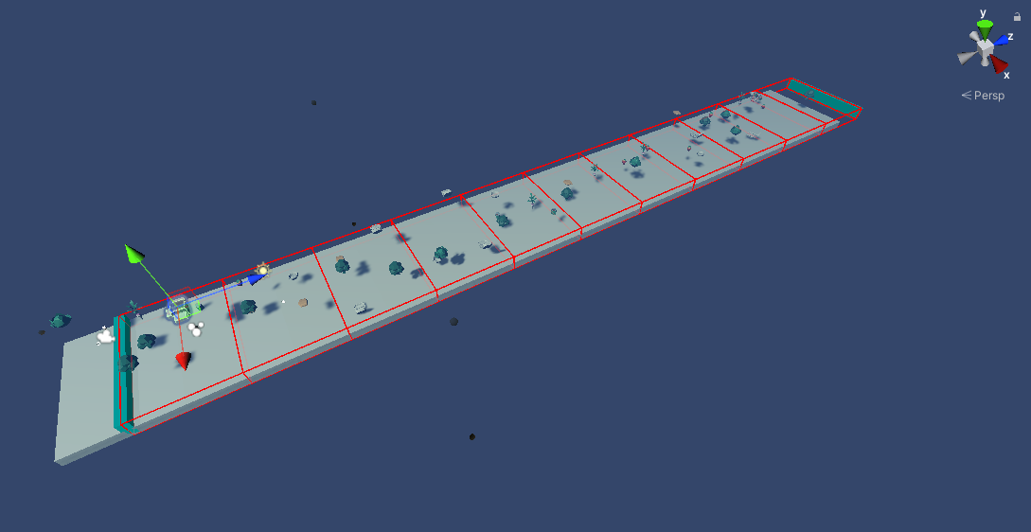
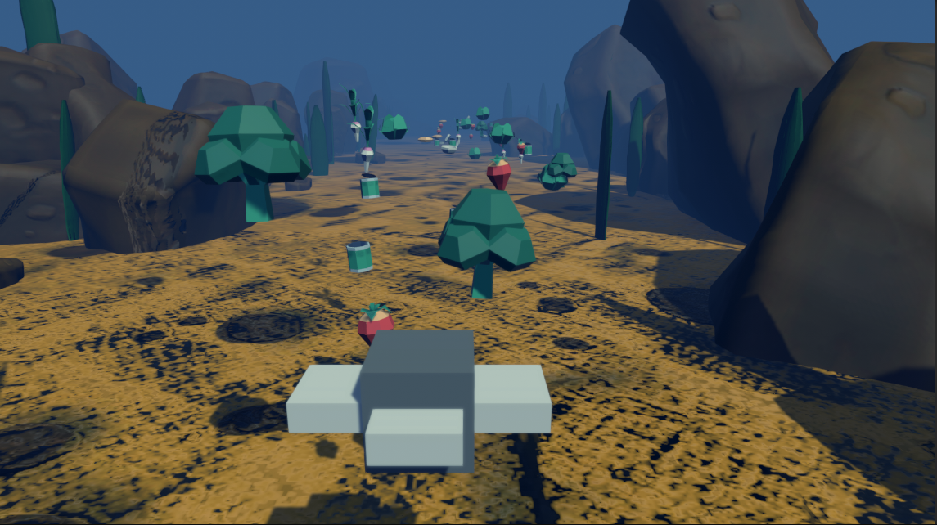
The Actual Game
Since we have an endless game, the main mechanic was procedurally generating the 'level'. Food/junk pickups are spawned in chunks and get removed once out of view.
The next feature we implemented was the turtle movement. It's controlled by the mouse and slowly rotates towards the direction of movement.
The last feature implemented is the hunger and health system. The player has to manage these two and at the same time dodge ocean junk.

Slide 17
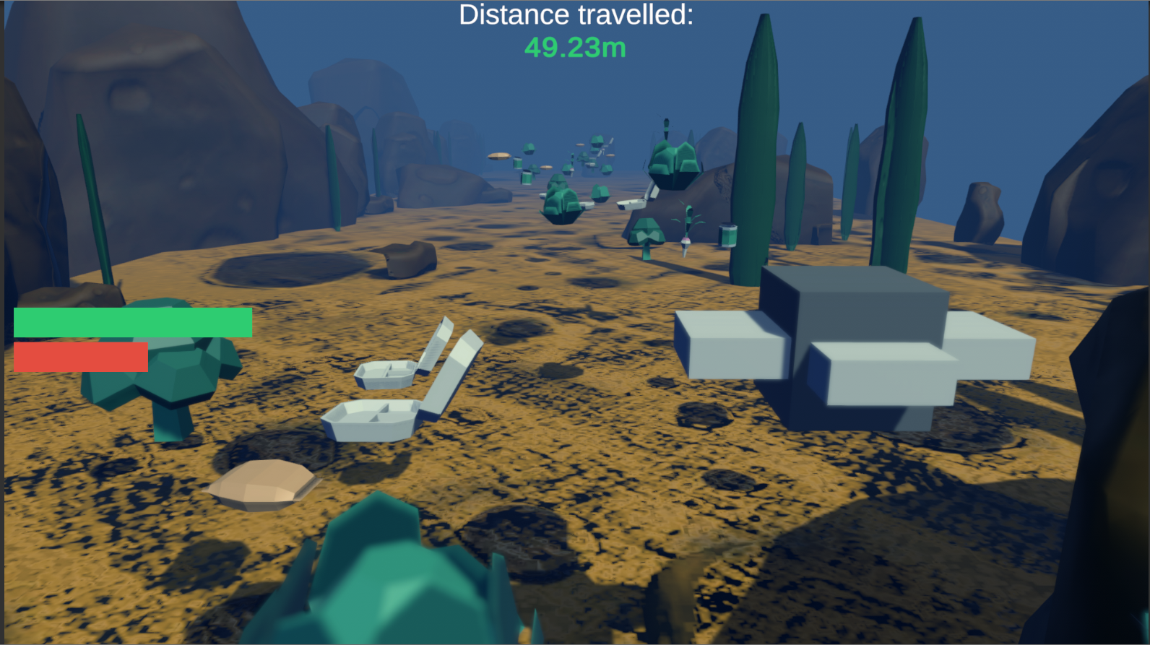
Gameplay
The main game obstacles are health and hunger. The player tries to keep the turtle from starving by catching food in an increasingly more and more polluted underwater world with less and less food to find.
Gameplay

Slide 18
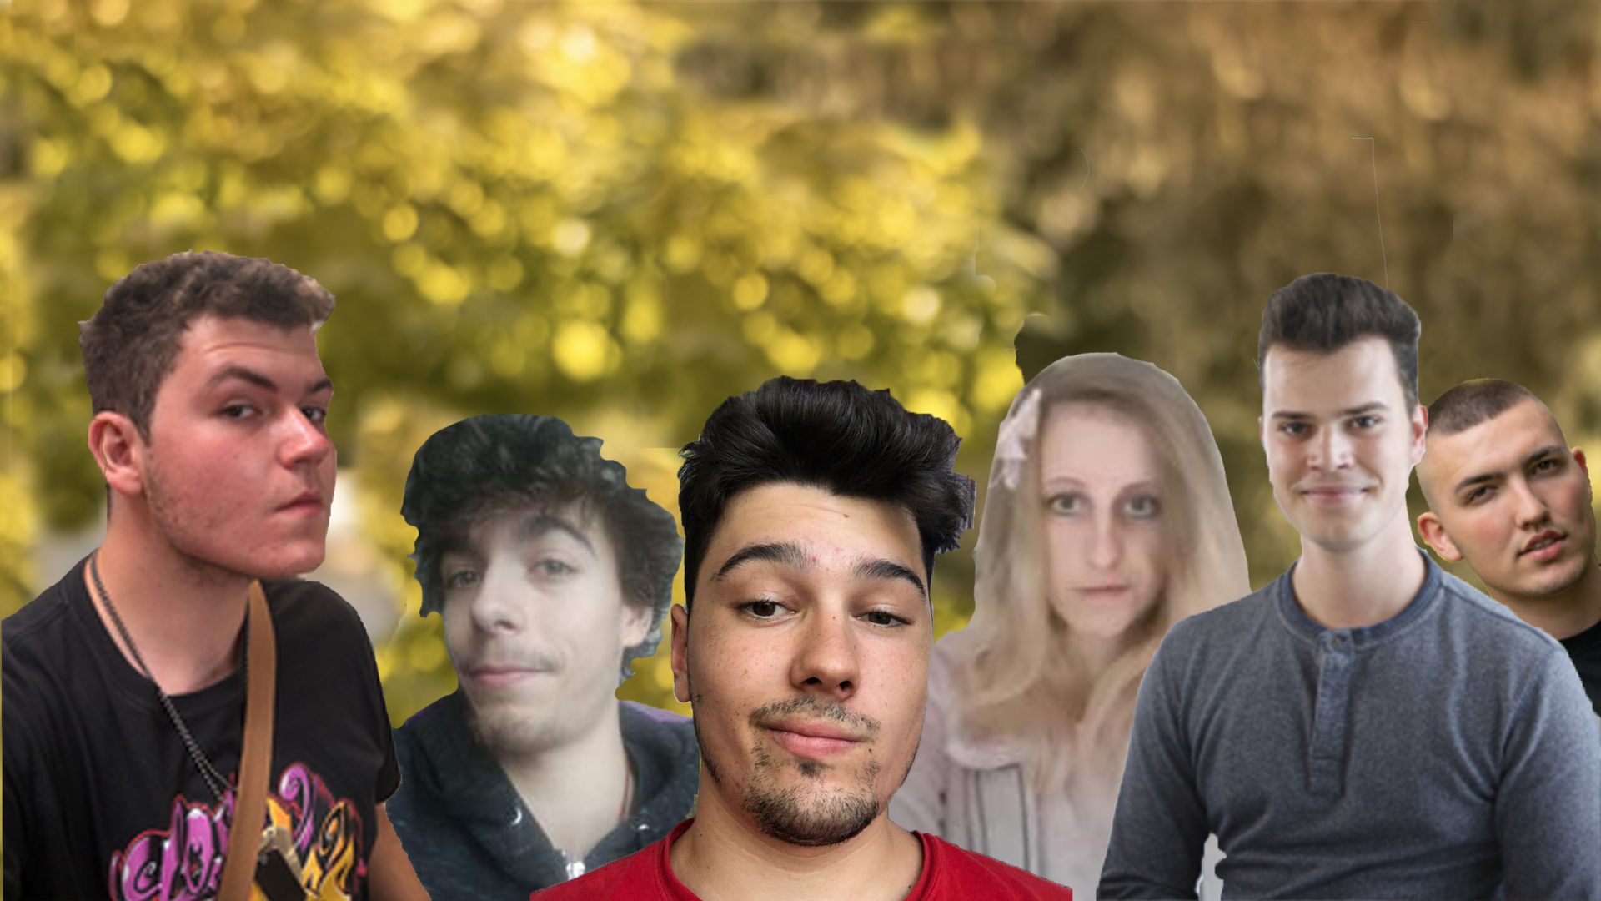
EAST COAST GANG

Slide 19
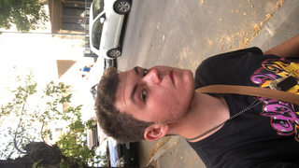
East Coast Gang: Rares
Designer
In charge of Documents.
I am managing Scrum.
I did the conceptualizing, ideation.
Was in charge of storyboard writing.
Helped with feedback for the website.
In charge of Main Menu UI/UX.

Slide 20
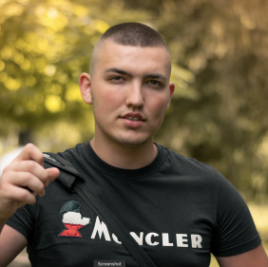
East Coast Gang: Mert
Designer
In charge of the website.
Sound Design of the game.
UI UX In-Game design.
Helped with storyboard ideation.

Slide 21
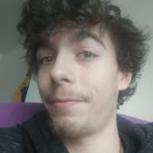
East Coast Gang: Vlad
Engineer
In charge of making the main menus.
He practically designed how to kill the turtles.
In charge of creating the hunger and hp bar.

Slide 22

East Coast Gang: Teo
Engineer
In charge of making the endless game mechanic.
Made the turtle movement and 'animation'.
Attempting to create the ocean look and feel.

Slide 23
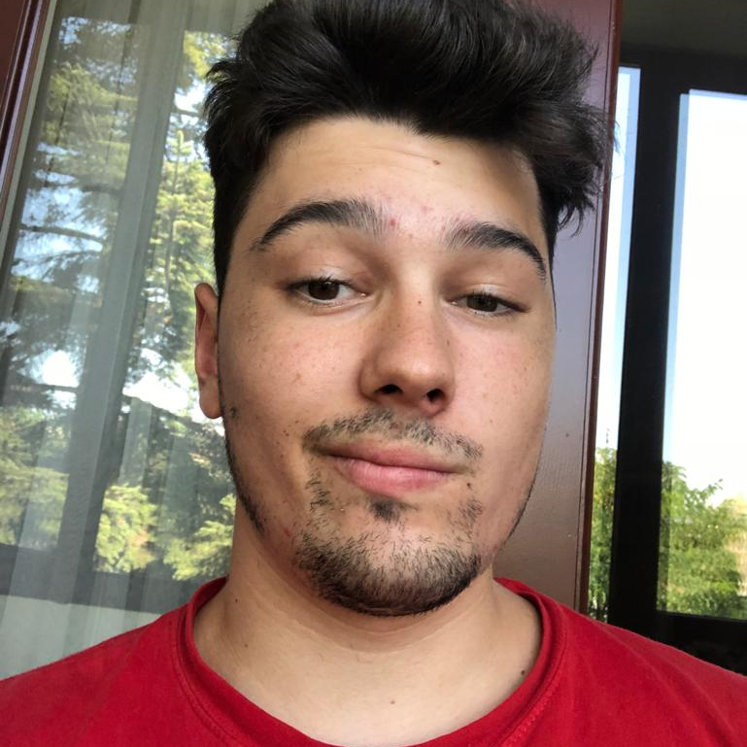
East Coast Gang: Tudor
.
Artist
Created Moodboard and Graphic Design Stylesheet.
In charge of the 3d assets: Modelling.
Texturing.
Rigging.
Animations.

Slide 24
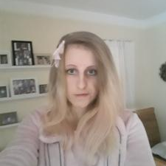
East Coast Gang: Julia
Artist
In charge of making the UI/UX prerequisites.
Made the Storyboard.
Game Assets.

